Slide 1

DEPARTMENT OF STATISTICS
FACULTY OF SCIENCE
THE MAHARAJA SAYAJIRAO UNIVERSITY OF BARODA
A Statistical Analysis on Automobile Sector
Guided By,
Dr.Deepa Kandpal
Group Members : Sujit, Saptarshi, Aesha, Parth, Pinal

Slide 2






















Automobile Sector
Two
Commercial
-
Passenger
Three
wheelers
vehicles
vehicle
-
wheelers
s
Mopeds and electric
al
Passenger cars
Light commerci
Passenger carriers
scooters
vehicles (LCV)
Scooters
Utility vehicles
Medium & heavy
Goods carrier
commercial vehicles
Multi
Motorcycles
-
purpose
vehicles

Slide 3
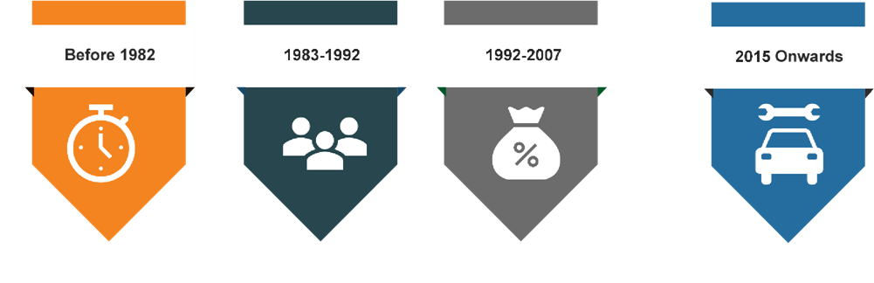
Evolution of the sector :
1983-1992
Indian Government & Suzuki formed Maruti Udyog and commenced production in 1983.
Component manufacturers entered the market via joint venture (JV).
Buyer’s market.
1992-2007
Sector de-licensed in 1993.
Major OEMs started assembly operations in India.
Imports permitted from April 2001.
Introduction of value
added tax in 2005
2015 Onwards
Automotive Mission Plan 2016-26 launched in 2015.
Bharat Stage (BS) IV emission norms since April 2017 and to adopt BSVI norms from 2020.
26.36 million vehicles produced in FY20.
Before 1982:
Closed market
Long waiting periods & outdated models
Seller’s market

Slide 4
About Dataset

Slide 5
Objectives
Forecast the production of automobiles.
Analysis the growth and trend in automobile sector over past decade.
Following data we will analysis for Time series method.

Slide 6









Graphical Representation
1.Registered Motor Vehicles in India (in millions) 2011-2020
YEAR | Number of Registered vehicles (in millions)
2011 |  | 141.9
2012 |  | 159.5
2013 |  | 176
2014 |  | 190.7
2015 |  | 210
2016 |  | 230
2017 |  | 253.3
2018 |  | 278.63
2019 |  | 306.5
2020 |  | 337.15
Number of Registred vehicles (In millions)
400
350
300
337.15
306.5
250
278.63
253.3
200
230
190.7
210
150
159.5
176
100
141.9
50
0
2011
2012
2013
2014
2015
2016
2017
2018
2019
2020
Conclusion :
There has been increase in the no. of registered motor vehicles in India since 2011.

Slide 7










2 . Number of Passengers by Road (in billion people per km) 2011 -2020
YEAR | Passenger by road (in billion people per km)
2011 | 8409
2012 | 9478
2013 | 10469
2014 | 11472
2015 | 13393
2016 | 15428
2017 | 17832
2018 | 20685
2019 | 23994
2020 | 27833
Passenger by road (In million People per Km)
Passenger by road (In million People per Km)
Linear (Passenger by road (In million People per Km))
Linear (Passenger by road (In million People per Km))
35000
30000
27833
25000
23994
20685
20000
17832
15000
13393
15428
9478
10469
11472
10000
8409
5000
0
2011
2012
2013
2014
2015
2016
2017
2018
2019
2020
Conclusion :
There has been also a continuous increase in the Passenger by road in India since 2011.

Slide 8
3.Export Volume of Vehicles(in 1000’s) 2011-2020
(i)
YEAR |  | Export Volume of Vehicles (in 1000's)
 | passenger vehicles | commercial vehicles | two wheelers | three wheelers
2011 | 444.3 | 74.04 | 1531.6 | 269.97
2012 | 508.78 | 92.26 | 1975.11 | 361.75
2013 | 559.41 | 80.03 | 1956.38 | 303.09
2014 | 596.14 | 77.05 | 2084 | 353.39
2015 | 621.34 | 86.94 | 2457.47 | 407.6
2016 | 653.05 | 103.12 | 2482.88 | 404.44
2017 | 758.73 | 108.27 | 2340.28 | 271.89
2018 | 748.37 | 96.87 | 2815 | 381
2019 | 676.19 | 99.93 | 3280.84 | 576.68
2020 | 677.31 | 60.71 | 3520.38 | 502.17
Export volume of passenger vehicles (in
1000
`s
)
800
700
600
500
400
300
200
100
0
2011
2012
2013
2014
2015
2016
2017
2018
2019
2020
Exports grew at 5.4% between 2011 to 2019.
While it grew by just 1% in 2020.
(ii)
Export volume of two wheelers (in 1000`s)
4000
3500
3000
2500
2000
1500
1000
500
0
2011
2012
2013
2014
2015
2016
2017
2018
2019
2020
Exports grew at almost 10% between 2011 to 2019.
While it grew by 7% in 2020

Slide 9
(iii)
Export volume of commercial vehicles (in
`s
1000
)
120
100
80
Export grew by 3.8% between 2011 to 2015.
whlie it fell by 39% in 2020.
60
40
20
0
2011
2012
2013
2014
2015
2016
2017
2018
2019
2020
Export volume of three wheelers (in 1000`s)
700
(iv).
600
Export grew by 9.9 %.
While it fell by 12%.
500
400
300
200
100
0
2011
2012
2013
2014
2015
2016
2017
2018
2019
2020

Slide 10
(4).Sales volume of vehicles(in thousands) 2011-2020
YEAR | Sales volume of Vehicles(in thousands)
 | Passenger vehicles | commercial vehicles | two wheelers | three wheelers
2011 | 2512 | 683 | 11830 | 532.1
2012 | 2605 | 812.5 | 13473 | 510.5
2013 | 2720 | 791.6 | 13800 | 542.4
2014 | 2500 | 632.84 | 14815 | 481.2
2015 | 2601.23 | 614.92 | 15975 | 532.6
2016 | 2789.2 | 685.7 | 16455 | 538.2
2017 | 3048 | 714.08 | 17590 | 511.9
2018 | 3288.5 | 856.92 | 20200 | 635.7
2019 | 3377.3 | 1007.32 | 21179 | 701
2020 | 2773.5 | 717.69 | 17417 | 636.5
(i)
Commercial vehicle sales volume (in
thousands)
1200
1000
800
600
400
200
0
2011
2012
2013
2014
2015
2016
2017
2018
2019
2020
Sales grew by 4.9 % between 2011 to 2019.
while it fell by 28% in 2020.
(ii).
Three wheeler sales volume (in thousands)
800
700
600
500
400
300
200
100
0
2011
2012
2013
2014
2015
2016
2017
2018
2019
2020
sales grew by 3.5 % while.
While it fell by 9.2 %

Slide 11
(iii).
Passenger vehicle sales Volume (in
thousands)
4000
3500
Sales grew by 3.78 %
While it fell by 17.8 %
3000
2500
2000
1500
1000
500
0
2011
2012
2013
2014
2015
2016
2017
2018
2019
2020
(iv).
Two wheelers sales (in thousands)
25000
sales grew by 7.5 %.
While it fell by 17.7 % in 2020
20000
15000
10000
5000
0
2011
2012
2013
2014
2015
2016
2017
2018
2019
2020

Slide 12
Statistical Analysis

Slide 14
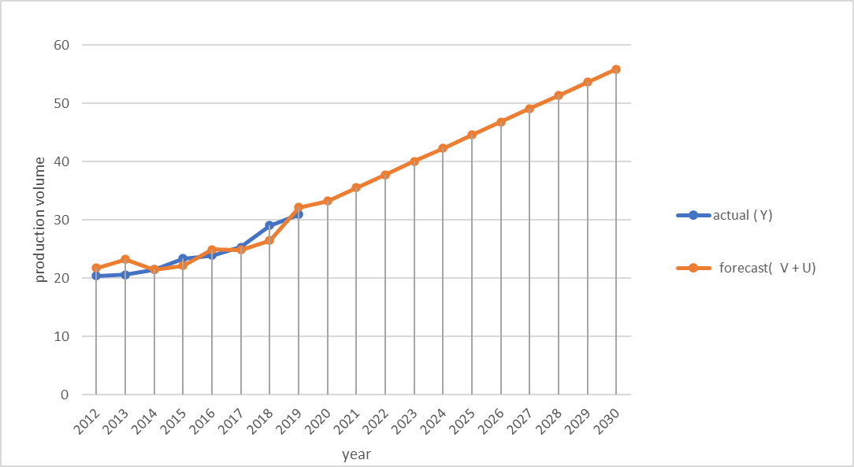
The production of vehicles will consistently grow in the coming decade. 2 wheelers will have the maximum production followed by passenger vehicles then 3 wheelers and commercial vehicles.

Slide 15
The government aims to have 30 % of the automobile sales to constitute of electric vehicles by the year 2030.
So in the year 2030, we calculated the electric sales for various segments :
2 wheelers = sales in 2030 * 30% , 3 wheelers = sales in 2030 * 30% , 4 wheelers = sales in 2030 * 30%.
Then we calculated CAGR from 2019 to 2030 the formula :
= (sales in 2030 / sales in 2019) ^ (1/n) – 1. Where n = 11 years.
After that we calculated the sales for every year assuming the CAGR.
For that aim to be achieved the sales of:
2 wheeler needs to grow annually at 49.80%.
3 wheeler needs to grow annually at 15.1%.
Passenger vehicle sales need to grow annually at 81.90 %.

Slide 17
2
wheeler sales (in million) for electric vehicles.
12
10
8
6
4
2
passenger vehicle sales (in million) for electric vehicles
0
3
2019
2020
2021
2022
2023
2024
2025
2026
2027
2028
2029
2030
2.5
3
wheelers sales (in millions) for electric vehicles
2
0.45
1.5
0.4
0.35
1
0.3
0.5
0.25
0.2
0
2019
2020
2021
2022
2023
2024
2025
2026
2027
2028
2029
2030
0.15
0.1
0.05
0
2019
2020
2021
2022
2023
2024
2025
2026
2027
2028
2029
2030

Slide 18
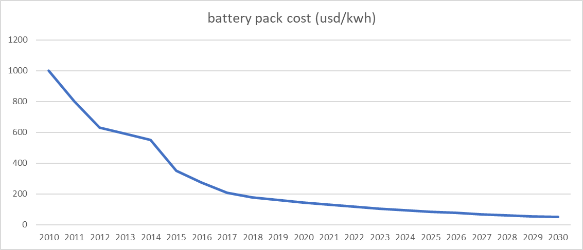
Up till 2019 the cost of battery pack was $160. Industry estimates forecasted that by 2030, the cost of battery pack will be $50.
Hence we applied the formula of CAGR. And then we estimated the cost of battery pack over the next decade.
Annually the cost of battery pack reduced at 10 % rate.

Slide 19
In 2019 a typical :
2 wheeler uses 2 GW of battery.
3 wheeler uses 4 GW of battery.
Passenger vehicle uses 20 GW of battery.
Assuming the cost of battery pack reduces over the years as calculated above ; manufacturers use the reduced cost to increase the battery size in the vehicle we arrive at the conclusion :
Formula used = (Battery pack of vehicle in 2019) x ($160) / ( cost of battery pack in the respective year)
YEAR | battery pack cost (usd/kwh) |  | 2 w battery pack (GWh) | 4 w battery pack (GWh) | 3 w battery pack (GWh)
2019 | 160 |  | 3 | 21 | 4
2020 | 144 |  | 3.333333 | 23.33333 | 4.444444
2021 | 130 |  | 3.692308 | 25.84615 | 4.923077
2022 | 117 |  | 4.102564 | 28.71795 | 5.470085
2023 | 105 |  | 4.571429 | 32 | 6.095238
2024 | 95 |  | 5.052632 | 35.36842 | 6.736842
2025 | 86 |  | 5.581395 | 39.06977 | 7.44186
2026 | 77 |  | 6.233766 | 43.63636 | 8.311688
2027 | 69 |  | 6.956522 | 48.69565 | 9.275362
2028 | 62 |  | 7.741935 | 54.19355 | 10.32258
2029 | 56 |  | 8.571429 | 60 | 11.42857
2030 | 50 |  | 9.6 | 67.2 | 12.8
Over the year it increases.
Then we proceed to calculate the overall industry battery requirement for the country.
We do it by simply :
= ( battery capacity of the vehicle ) x ( sales volume of that vehicle in the respective year )

Slide 20
 |  | Battery requirement (GWh)
YEAR | 2 w | 4 w | 3 w | SUM ( 2w + 3w + 4w) | Cummulative
2019 | 0.456 | 0.0714 | 0.56 | 1.0874 | 1.0874
2020 | 0.479457 | 0.137783 | 0.3927911 | 1.010031111 | 2.097431111
2021 | 1.259404 | 0.290764 | 0.9130936 | 2.463261439 | 4.56069255
2022 | 2.096208 | 0.587666 | 1.1677453 | 3.851619235 | 8.412311786
2023 | 3.498991 | 1.191131 | 1.4976834 | 6.187805443 | 14.60011723
2024 | 5.793224 | 2.394738 | 1.9052897 | 10.09325169 | 24.69336892
2025 | 9.586438 | 4.811893 | 2.4224873 | 16.82081769 | 41.5141866
2026 | 16.03898 | 9.775891 | 3.114186 | 28.92905905 | 70.44324566
2027 | 26.81206 | 19.84407 | 4.000014 | 50.65614513 | 121.0993908
2028 | 44.69917 | 40.17175 | 5.1238243 | 89.99474823 | 211.094139
2029 | 74.13357 | 80.90161 | 6.5293992 | 161.5645809 | 372.6587199
2030 | 125.2259 | 165.1784 | 8.4301808 | 298.8344962 | 671.4932162
 | total battery requirement (GWh) = 671 GWh by the end of 2030.
battery requirement ( GWh)
800
700
600
500
400
300
200
100
0
2019
2020
2021
2022
2023
2024
2025
2026
2027
2028
2029
2030
We see that by the year 2030 the battery requirement of the entire country will be between 600 to 1000 GWh.
The government will need to invest highly and provide subsidies to private players to install Giga factories and keep up with demand.

Slide 21
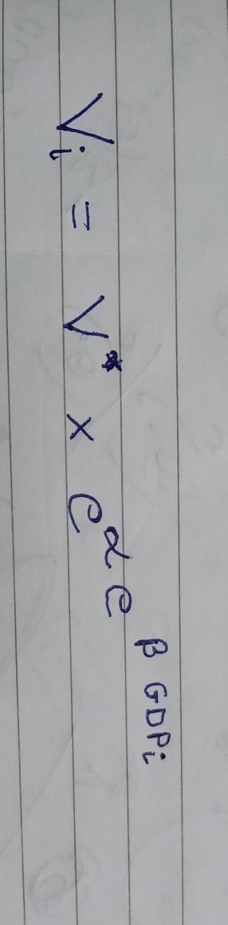
Gompertz Method
The Gompertz curve or Gompertz function is a type of mathematical model for a time series, named after Benjamin Gompertz (1779–1865).
It is a sigmoid function which describes growth as being slowest at the start and end of a given time period.
The right-hand or future value asymptote of the function is approached much more gradually by the curve than the left-hand or lower valued asymptote. This is in contrast to the simple logistic function in which both asymptotes are approached by the curve symmetrically.
It is a special case of the generalised logistic function.
The Gompertz function is widely applied to establish the relationship between vehicle ownership and economic factors .
The Gompertz function is used here to estimate country-level vehicle ownership as follows :

Slide 22
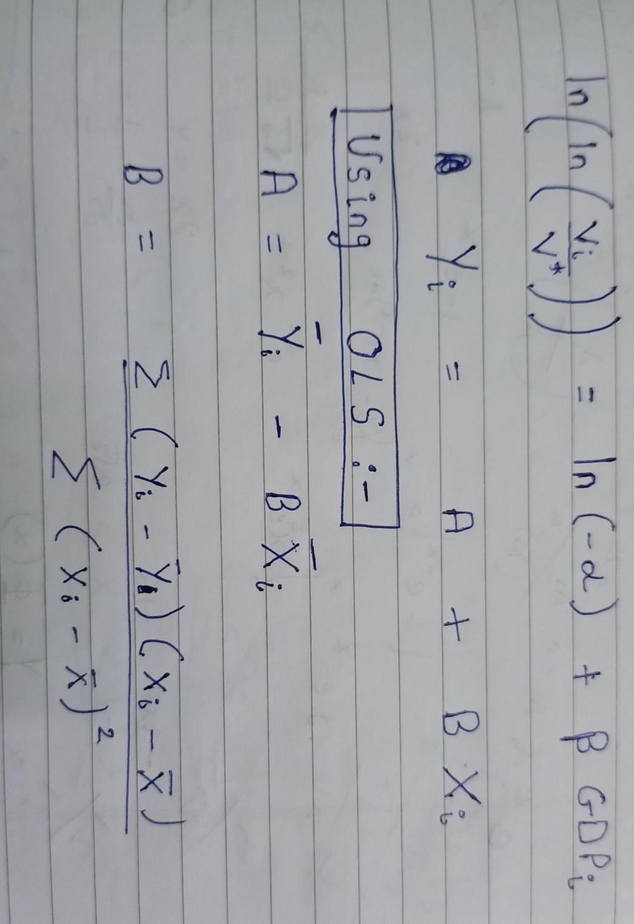
where i different years; V(i) represents the vehicle ownership (vehicles per 1000 people) ; Vi * represents the ultimate saturation level of vehicle ownership (vehicles per 1000 people) of country .
Given the parameters of α and β, V(i) changes in proportion to the change of Vi* GDP(i) represents the economic factor (per capita GDP). α and β are two negative parameters that determine the shape of the S-curve.
The increase of α and β would lead to a steep S-shape curve against the economic factors.
Log-linearization :
ln (−α) and β were linearly related and could be regressed as OLS for time series data of country.
Now we will calculate the 2 wheeler and Passenger vehicle ownership. Data of GDP, Population, vehicles were available till 2019.
We projected GDP uptill 2041. GDP will grow at 8 % from 2021 to 2030. And then at 6 % from 2030 to 2041.
Population will reach 1.5 billion till 2030 and 1.6 billion till 2041. We calculated it by decrease rate of growth method. GDP per capita (Xi) = (GDP) / (Population).

Slide 23
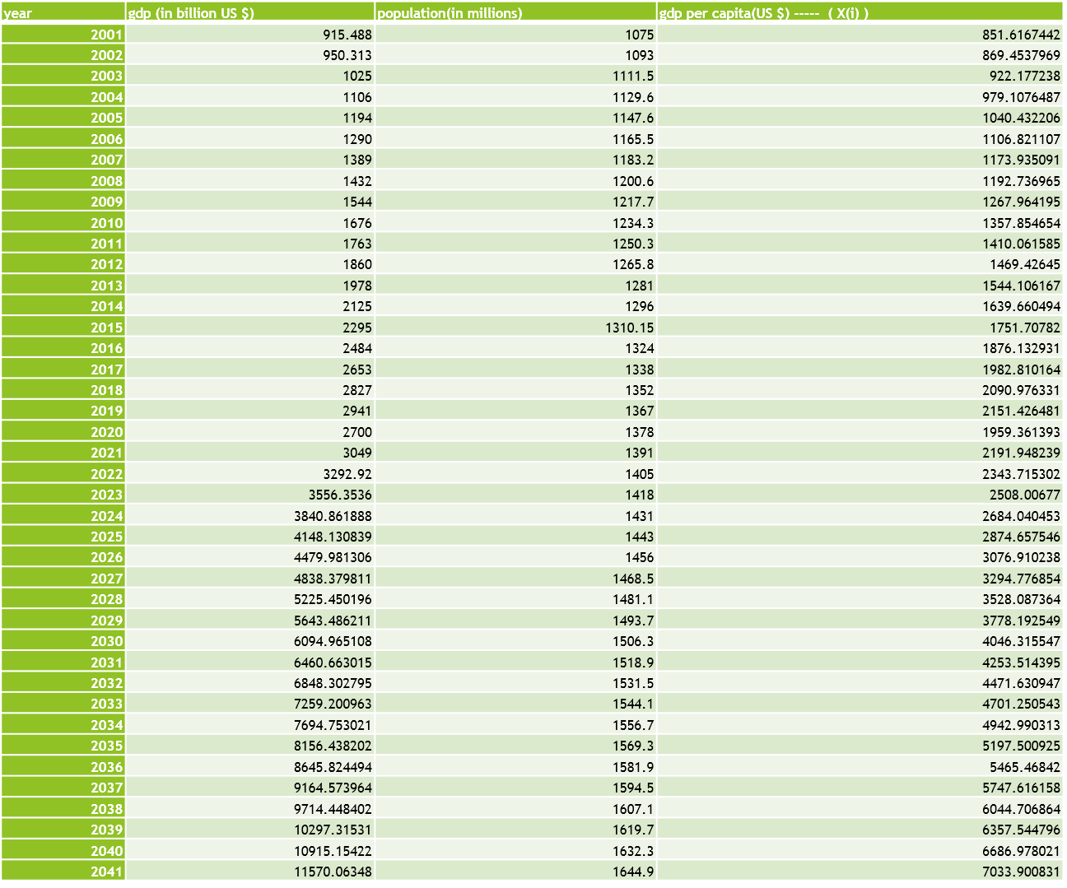

Slide 24
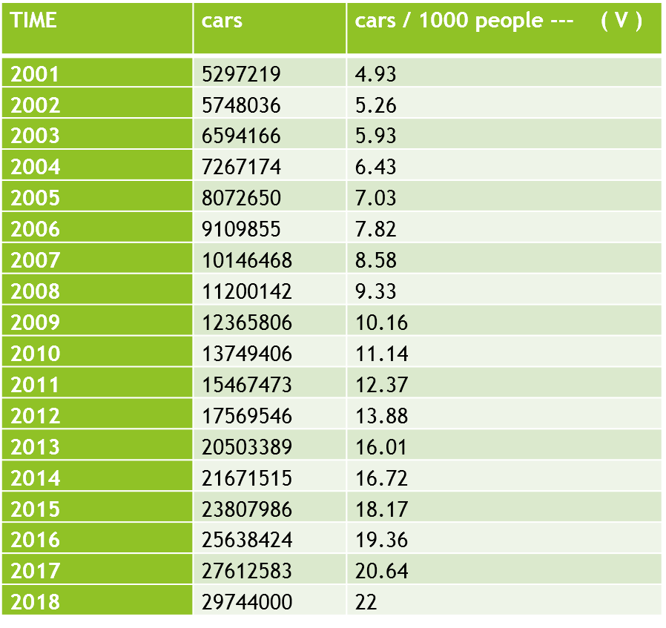
We assumed the saturation level of Cars per 1000 people to be 250.
It is assumed by looking at data of other Asian developed countries who have already reached the saturation level.

Slide 26
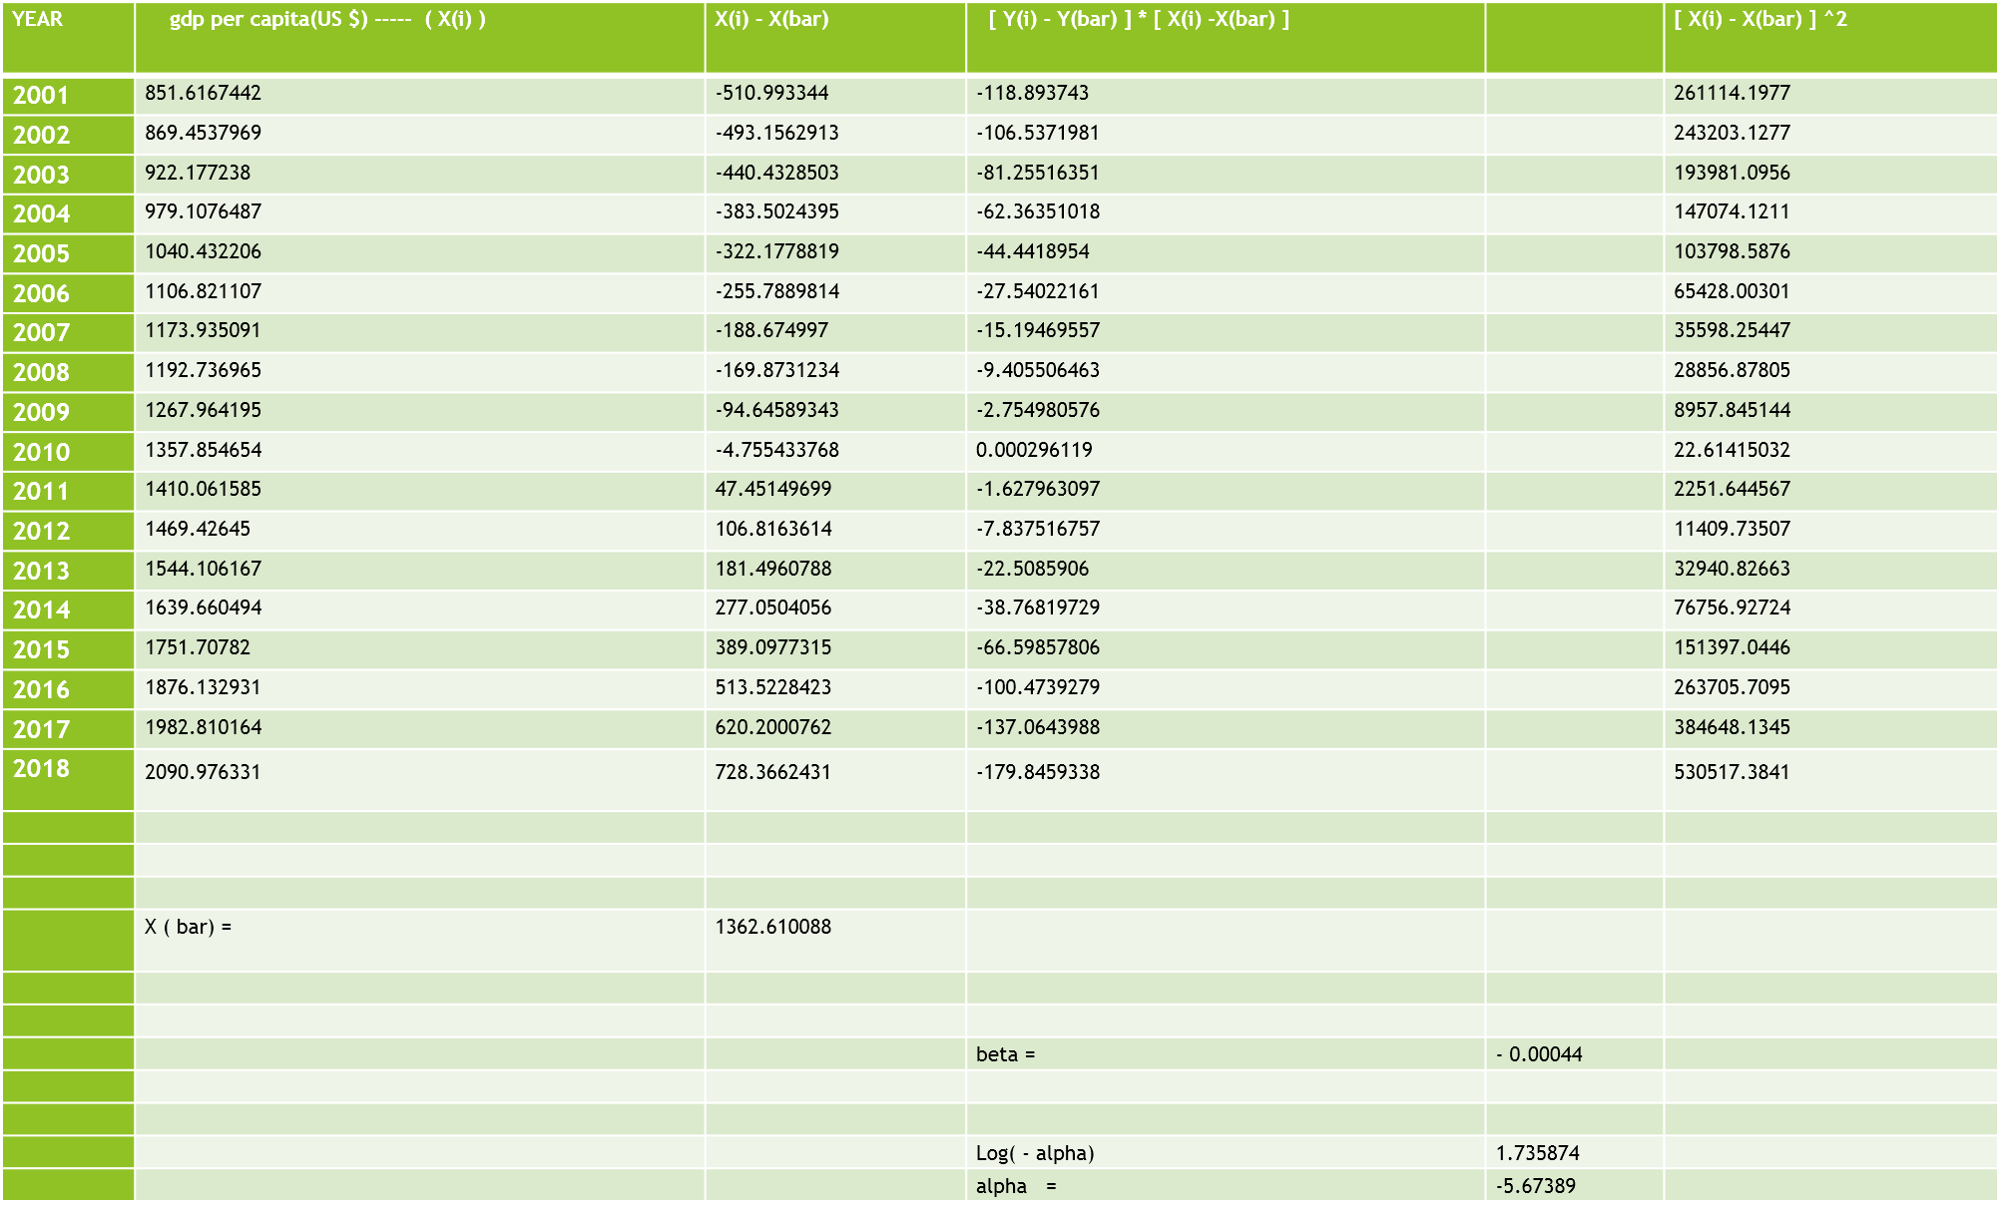

Slide 27
.
year | cars /1000 People
2001 | 5.1
2002 | 5.2
2003 | 5.7
2004 | 6.3
2005 | 6.9
2006 | 7.7
2007 | 8.5
2008 | 8.7
2009 | 9.8
2010 | 11.1
2011 | 11.9
2012 | 12.9
2013 | 14.1
2014 | 15.9
2015 | 18.2
2016 | 20.9
2017 | 23.4
2018 | 26.2
2019 | 27.8
2020
2021 | 28.9
2022 | 33.2
2023 | 38.2
2024 | 44
2025 | 50.6
2026 | 58
2027 | 66.3
2028 | 75.5
2029 | 85.6
2030 | 96.4
2031 | 104.8
2032 | 113.5
2033 | 122.5
2034 | 131.6
2035 | 140.9
2036 | 150.2
2037 | 159.4
2038 | 168.5
2039 | 177.3
2040 | 185.7
2041 | 193.7
Hence by 2030 there will be 96 cars per 1000 people,
And by 2041 there wiil be 194 cars per 1000 people.
cars /1000 People
250
200
150
100
50
0
2001
2003
2005
2007
2009
2011
2013
2015
2017
2019
2021
2023
2025
2027
2029
2031
2033
2035
2037
2039
2041

Slide 28
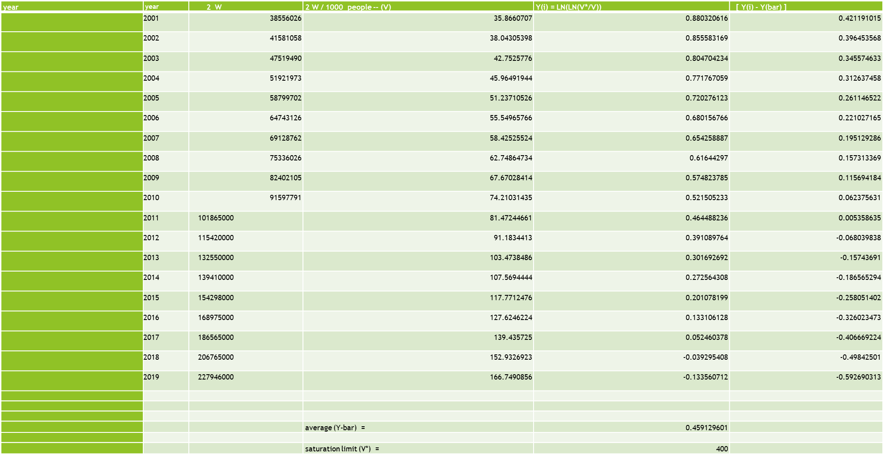
We assume that the saturation limit will be 400 two wheeler per 1000 people.

Slide 29
We assumed it by looking at the data of various developed Asian countries.
year | gdp per capita(US $) -- (X(i)) | X(i) - X(bar) | [ Y(i) - Y(bar) ] * [ X (i) - X(bar) | ][ X(i) - X(bar) ] ^ 2
2001 | 851.6167442 | -552.5099963 | -232.7122461 | 305267.296
2002 | 869.4537969 | -534.6729436 | -211.972996 | 285875.1566
2003 | 922.177238 | -481.9495025 | -166.5495224 | 232275.323
2004 | 979.1076487 | -425.0190918 | -132.8768883 | 180641.2284
2005 | 1040.432206 | -363.6945342 | -94.97756251 | 132273.7142
2006 | 1106.821107 | -297.3056337 | -65.71262126 | 88390.63982
2007 | 1173.935091 | -230.1916492 | -44.91713207 | 52988.19537
2008 | 1192.736965 | -211.3897756 | -33.25443773 | 44685.63725
2009 | 1267.964195 | -136.1625457 | -15.75321459 | 18540.23885
2010 | 1357.854654 | -46.27208604 | -2.886250574 | 2141.105946
2011 | 1410.061585 | 5.934844722 | 0.031802666 | 35.22238187
2012 | 1469.42645 | 65.29970918 | -4.442981625 | 4264.052019
2013 | 1544.106167 | 139.9794266 | -22.03792835 | 19594.23986
2014 | 1639.660494 | 235.5337533 | -43.94242389 | 55476.14896
2015 | 1751.70782 | 347.5810792 | -89.69378484 | 120812.6066
2016 | 1876.132931 | 472.00619 | -153.8850975 | 222789.8434
2017 | 1982.810164 | 578.6834239 | -235.3327388 | 334874.5051
2018 | 2090.976331 | 686.8495909 | -342.343014 | 471762.3605
2019 | 2151.426481 | 747.2997408 | -442.9173176 | 558456.9027
Average (X-bar) = |  | 1404.12674
 |  |  | beta = | -0.000752756
 |  |  |  | 1.516093845
 |  |  | alpha = | -4.554400211

Slide 30
.
year | Projected 2 W/1000 People
2001 | 36
2002 | 38
2003 | 41
2004 | 45
2005 | 50
2006 | 55
2007 | 61
2008 | 63
2009 | 69
2010 | 78
2011 | 83
2012 | 89
2013 | 96
2014 | 106
2015 | 118
2016 | 132
2017 | 144
2018 | 156
2019 | 162
2020
2021 | 167
2022 | 183
2023 | 201
2024 | 219
2025 | 237
2026 | 255
2027 | 273
2028 | 290
2029 | 307
2030 | 322
2031 | 332
2032 | 342
2033 | 350
2034 | 358
2035 | 365
2036 | 371
2037 | 377
2038 | 381
2039 | 385
2040 | 388
2041 | 391
Hence by 2030 there will be 322 two wheelers by per 1000 people.
And by 2041 there will be 393 two wheelers per 1000 people i.e we will near our saturation limit.
Projected 2 W/1000 People
450
400
350
300
250
200
150
100
50
0
2001
2003
2005
2007
2009
2011
2013
2015
2017
2019
2021
2023
2025
2027
2029
2031
2033
2035
2037
2039
2041

Slide 31
.
year |  | vehicles | vehicles / 1000 people -- (V) | Y(i) = LN(LN(V*/V)) | [ Y(i) - Y(bar) ]
 | 2001 | 54991026 | 51.15444279 | 0.961734728 | 0.321755405
 | 2002 | 58924337 | 53.91064684 | 0.941471946 | 0.301492622
 | 2003 | 6700284 | 6.028145749 | 1.559121168 | 0.919141844
 | 2004 | 72717935 | 64.37494246 | 0.869767462 | 0.229788138
 | 2005 | 85101719 | 74.15625566 | 0.808663607 | 0.168684284
 | 2006 | 89618267 | 76.89254998 | 0.792391132 | 0.152411809
 | 2007 | 96707260 | 81.7336545 | 0.764357687 | 0.124378363
 | 2008 | 105353854 | 87.75100283 | 0.730720886 | 0.090741563
 | 2009 | 114951033 | 94.40012565 | 0.694914583 | 0.05493526
 | 2010 | 127745972 | 103.4966961 | 0.647909537 | 0.007930214
 | 2011 | 141956000 | 113.537551 | 0.598257601 | -0.041721722
 | 2012 | 159500000 | 126.0072681 | 0.539261901 | -0.100717423
 | 2013 | 176000000 | 137.392662 | 0.487498057 | -0.152481266
 | 2014 | 190700000 | 147.1450617 | 0.444468759 | -0.195510564
 | 2015 | 210000000 | 160.28699 | 0.388057429 | -0.251921894
 | 2016 | 230000000 | 173.7160121 | 0.331932292 | -0.308047031
 | 2017 | 253300000 | 189.3124066 | 0.268255905 | -0.371723418
 | 2018 | 278630000 | 206.0872781 | 0.201127426 | -0.438851898
 | 2019 | 306500000 | 224.2136064 | 0.129695038 | -0.510284285
 |  |  | average (Y-bar) = | 0.639979323
 |  |  | saturation limit (V*) = | 700

Slide 32
We will now predict the total number of vehicles owned per 1000 people till the year 2041. We will take the saturation limit to be 700 vehicles per 1000 people, as observed from other developed nations.
year | gdp per capita(US $) -- (X(i)) | X(i) - X(bar) | [ Y(i) - Y(bar) ] * [ X (i) - X(bar) | ][ X(i) - X(bar) ] ^ 2
2001 | 851.6167442 | -552.5099963 | -177.7730774 | 305267.296
2002 | 869.4537969 | -534.6729436 | -161.1999479 | 285875.1566
2003 | 922.177238 | -481.9495025 | -442.9799545 | 232275.323
2004 | 979.1076487 | -425.0190918 | -97.66434583 | 180641.2284
2005 | 1040.432206 | -363.6945342 | -61.34955199 | 132273.7142
2006 | 1106.821107 | -297.3056337 | -45.3128894 | 88390.63982
2007 | 1173.935091 | -230.1916492 | -28.63086057 | 52988.19537
2008 | 1192.736965 | -211.3897756 | -19.18183864 | 44685.63725
2009 | 1267.964195 | -136.1625457 | -7.48012482 | 18540.23885
2010 | 1357.854654 | -46.27208604 | -0.366947528 | 2141.105946
2011 | 1410.061585 | 5.934844722 | -0.247611943 | 35.22238187
2012 | 1469.42645 | 65.29970918 | -6.57681841 | 4264.052019
2013 | 1544.106167 | 139.9794266 | -21.3442402 | 19594.23986
2014 | 1639.660494 | 235.5337533 | -46.04933695 | 55476.14896
2015 | 1751.70782 | 347.5810792 | -87.56328395 | 120812.6066
2016 | 1876.132931 | 472.00619 | -145.4001056 | 222789.8434
2017 | 1982.810164 | 578.6834239 | -215.1101804 | 334874.5051
2018 | 2090.976331 | 686.8495909 | -301.4252463 | 471762.3605
2019 | 2151.426481 | 747.2997408 | -381.3353139 | 558456.9027
Average (X-bar) = |  | 1404.12674
 |  |  | beta = | -0.000779985
 |  |  |  | 1.73517762
 |  |  | alpha = | -5.66993481

Slide 33
.
year | Projected vehicles /1000 People
2001 | 38
2002 | 39
2003 | 44
2004 | 50
2005 | 56
2006 | 64
2007 | 72
2008 | 75
2009 | 85
2010 | 98
2011 | 106
2012 | 115
2013 | 128
2014 | 144
2015 | 165
2016 | 188
2017 | 209
2018 | 231
2019 | 243
2020
2021 | 251
2022 | 281
2023 | 314
2024 | 348
2025 | 383
2026 | 419
2027 | 454
2028 | 487
2029 | 520
2030 | 550
2031 | 570
2032 | 589
2033 | 606
2034 | 621
2035 | 634
2036 | 646
2037 | 657
2038 | 665
2039 | 673
2040 | 679
2041 | 684
We come to the conclusion that by 2030 there will be 550 vehicles per 1000 people.
And by 2041 we will attain the near saturation limit of 684 vehicles per 1000 people.
Projected vehicles /1000 People
800
700
600
500
400
300
200
100
0

Slide 34
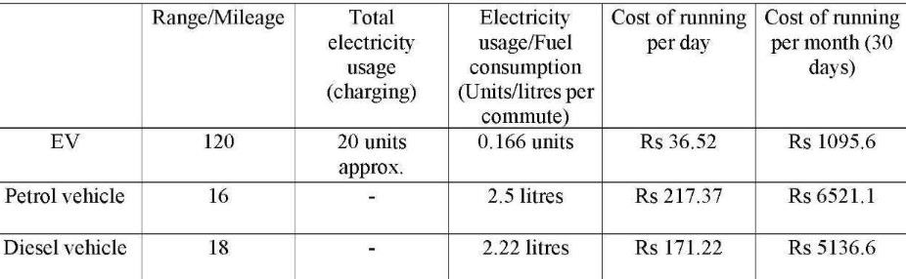
Petrol in Delhi costs Rs 86.95 , diesel costs Rs 77.13 and the electricity charges in Delhi range between Rs 3/unit to Rs 8/unit depending on the usage. So, for this example, we’ll settle for the average at Rs 5.5/unit. For an EV, we’ll take an average range of 120 km while we take the average mileage of a petrol vehicle at 16 kmpl and a diesel vehicle at 18 kmpl. We consider an average commute of 40 km/day for the vehicles.

Slide 35
The cost of running of an EV is around 84% less than the petrol counterpart and around 80% less than the diesel counterpart.
Low cost of maintenance:
Lithium-ion battery costs are reducing and India is gearing towards serious investment in high-performance batteries. Currently, EV batteries, for instance, have up to 90% capacity after driving 241,000 kms.
The typical Indian driver doesn't even complete the distance which is given above, and for those who even complete the target, EV companies give them a guarantee of 1,60,000 km/eight years of the battery.
An internal combustion vehicle requires servicing of several movable parts in a timely manner. On the other hand, the only scheduled service for an EV is the change of coolant after every 10,000 kilometres.

Slide 36
References
https://www.mospi.gov.in/web/mospi/reports-publications//reports/view/templateTwo/9504?q=TBDCAT
https://www.siam.in/statistics.aspx?mpgid=8&pgidtrail=13
https://www.siam.in/statistics.aspx?mpgid=8&pgidtrail=14
https://www.siam.in/statistics.aspx?mpgid=8&pgidtrail=15
http://www.siamindia.com/scripts/auto-policy.aspx
Annual survey of industries (ASI), Central statistical organization (CSO)
J P Sharma and Bhatnagar opp.cit. Central statistical organization (CSO) , Statistical abstract India.
siam analysis (Society of Indian automobile manufacturers), JP Sharma and Anjali Bhatnagar. Opp.cit.
Exports of automotive products of selected regions and economies by destination 2014, World Trade Organization, https://www.wto.org/english/res_e/statis_e/its2015_e/its15_merch_trade _ product_e.htm, accessed June 2016.

Slide 37
Thank you🙏

